Slide 2
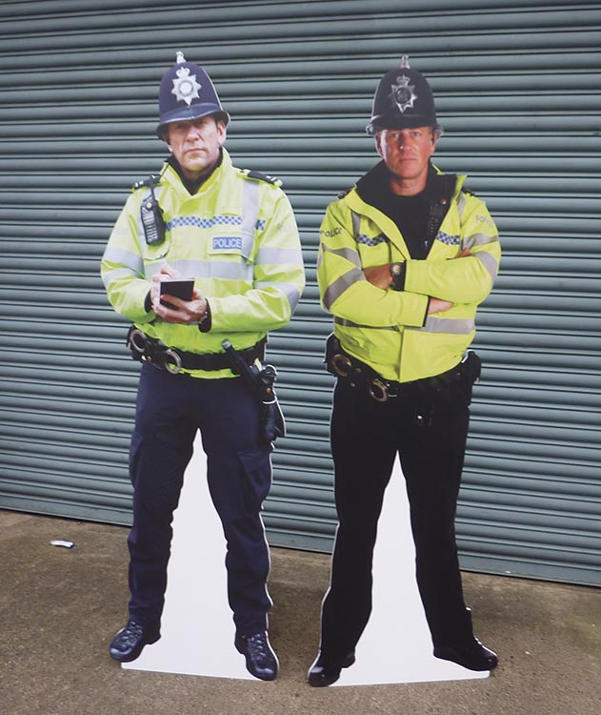



Disclaimer
Don’t do illegal shit

Slide 3
Overview
What is Steganography
Examples
Tools
Least significant bit
Spectrographs
Challenges

Slide 4
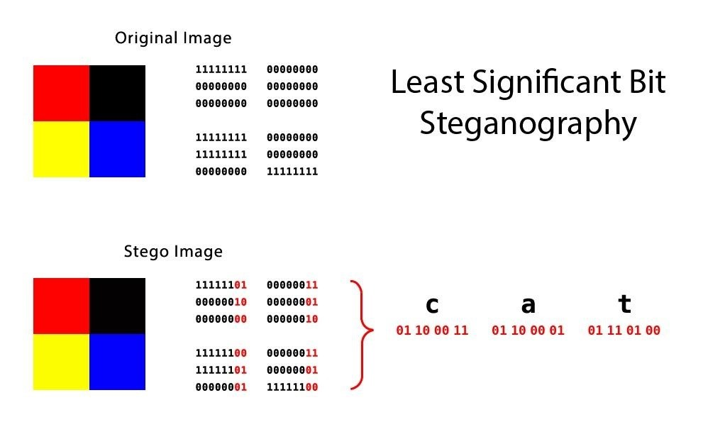
What is Steganography?
Practise of concealing or hiding data in readily available mediums - such as an image or video.
The word steganography comes from the ancient greek steganos (concealed) and graphia(writing)

Slide 5
Interesting Historical Examples
Demaratus warned the spartans of an invasion from Xerxes by hiding a message underneath the wax of a greek writing tablet
Johannes Trithemius in his famous book Steganographia hid an entire book on steganography inside a book about magic using steganography
Microdots where microfilm chips created by the Nazis that were the size of periods on a type writer but once magnified could have pages of data and images.
The underground railway would create quilts with hidden messages telling slaves where to go to escape slave states
“Subliminal messaging” was tested by the CIA in the 70s and consisted of secret messages hidden in films shown in cinemas which had advertisements like (go to the snackbar)

Slide 6
Steganography Tools
Steghide
A command line software that allows you to hide data in audio or image files
Examples
$ steghide embed -cf picture.jpg -ef secret.txt
This embeds “secret.txt” in “picture.jpg.”
Then you need to enter a passphrase “Enter passphrase:”
$ steghide extract -sf picture.jpg
Enter passphrase:
wrote extracted data to "secret.txt".
This allows you to extract “secret.txt”
$ steghide info received_file.wav
This command allows you to get information from an encrypted file
https://steghide.sourceforge.net/documentation.php

Slide 7

Steganography Tools p2
Spectrographs (audio steganography) are a common method of hiding data in audio files. You can view the spectrograph of an audio file using programs like audacity or sonic visualiser

Slide 8
Least Significant Bit
Least Significant Bit steganography allows you to replace the least significant bit of pixels in an image with data bits. This is easy to implement and allows you to hide data inside an image

Slide 9
Practical
Use Steghide to
Get the hidden text from an image file
Get the hidden text from a .wav file
Use steghide to hide your own secret text in an image file
Challenge - use https://incoherency.co.uk/image-steganography/ to find the image of the cat hidden in the image of the tree
Extra hard challenge Find the flag hidden in the spectrograph of the .mp3 file
Answer for last weeks hard challenge

